Slide 1
How you can become a financial data scientist (quant)
And build optimal portfolios like a Wall Street professional

Slide 2
Introduction
My name is Daniel Barrera
I’m a Mexican immigrant and I’m a quant (aka financial data scientist)
What is a quant?
What is a financial data scientist?
Where do they differ?

Slide 3
Objective
To show how the professionals at Wall Street manage money for investors
By the end of the talk, I want everyone to build their own optimal portfolios using data downloaded from Yahoo Finance

Slide 4
What is a quant?
Financial Markets
Investing
(Long Term)
Active
Passive
Trading
(Short Term)
Fundamental (Intuitive)
Quantitative (Scientific)

Slide 5



Return or why are investment decisions important?

Slide 6
How much money can I make if I start with $1,000 USD?
 | S&P 500 Index | Nasdaq Index | 10-year Govt Bond
In 50 years | 12 X | 25 X | 6 X
In 50 years | $12,000 | $25,000 | $6,000

Slide 7

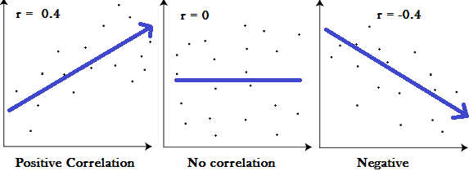
Risk
A measure of fluctuation and potential loss
It’s measured through standard deviation
Mathematical properties
Correlation
Learning: Do not take more risk than you can tolerate

Slide 8

Introduction

Slide 9
Invest using the scientific method
Like a Wall Street professional

Slide 10
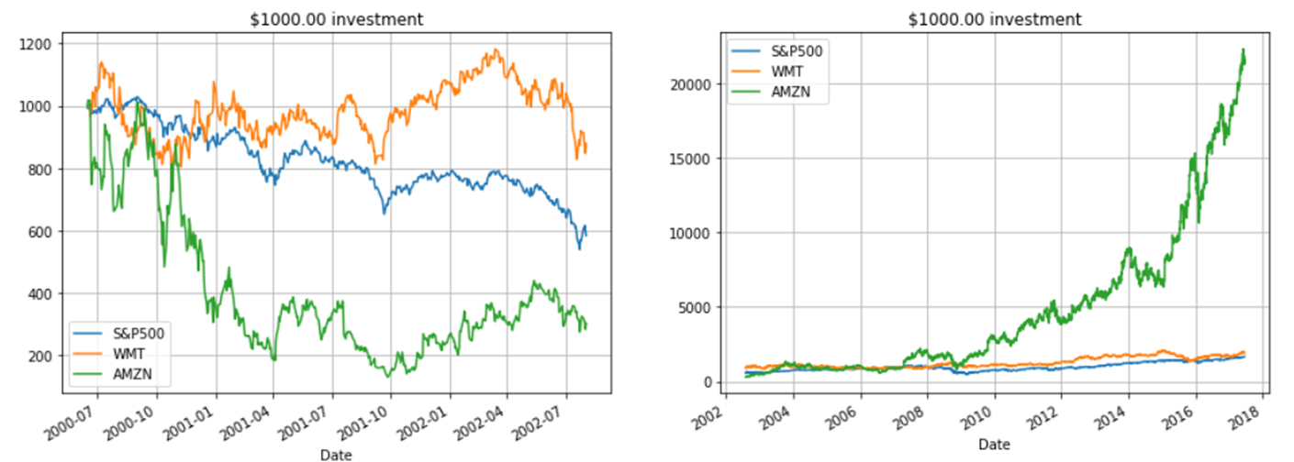
Story of Johnny, mom and pop

Slide 11
Optimal portfolio theory
Not all portfolios are optimal!
Sub-optimal portfolio
Diversification works!!!

Slide 12
Noble prize quality research
Markovitz portfolio theory, 1952
Sharpe-Lintner-Black CAPM (one factor model), 1964
Fama-French (3 factor model), 1993
Carhart (4 factors), 1997
AQR Cliff Asness (6/5 factors), 2015
MSCI (16 global factors + country + industries), 2016
Almost 70 years of research following the scientific method

Slide 13
Nobel Prize Research: Iterative Process
Factor models evolved iteratively
Most frequently studied fundamental models
CAPM (Sharpe 1964)
Only market excess returns explain any asset’s returns
Fama-French 3 factors (1993)
Market excess returns plus Size and Value
Fama-French-Carhart 4 factors (1997)
FF 3 factors plus Momentum
Fama-French 5 factors (2015)
FF 3 factors plus Profitability and Investment
AQR Cliff Asness 6|5 factors (2015)
FF 5 factors plus MOM, different Value definition
Empirical tests
Informal / Exploratory
Construct portfolios based on suspect factors
See if the model explains the spread
Formal
Fama-Macbeth (FM) Regressions

Slide 14
William Sharpe - 1965
Ok, let’s build a model: CAPM
The whole market moves individual stocks
Simple and elegant econometric model
Beta is the only parameter
Beta determines the future returns

Slide 15
Fama & French - 1993
Beta can’t be the only factor
Experiment 1: Divide stocks in 10 buckets by Size and see if Beta explains the returns in all of them
Experiment 2: Divide stocks in 10 buckets by Value and see if Beta explains the returns in all of them

Slide 16
Ronald Kahn – Current day
Hundreds of quantitative managers, and some quant-mental
Dozens of factors discovered
Active management is possible, but not easy
Consistent success requires art: seeing what others miss
But also, the science: optimally investing on those ideas
We can offer a process, but not a guarantee of success

Slide 17
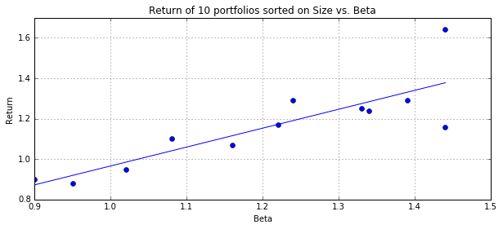
CAPM
Capital Asset Pricing Model marks the birth of Asset Pricing Theory
Attributed to Sharpe(1964), Lintner(1965) and Black(1972) (aka SLB)
Consensus by 1980:
Elegant and intuitive 1-factor model that builds on Markowitz modern portfolio theory
Beta is related to average returns of stocks
The relationship (between beta and asset returns) is close to linear as predicted by CAPM
Some imperfections are noticed regarding slope and intercept

Slide 18
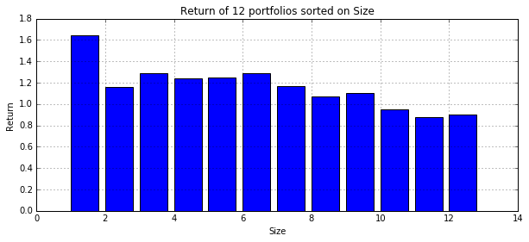
Anomalies: Size Decile Portfolios
Fama-French analysis:
Portfolios formed on Size present decreasing Returns!!!
Is it Beta or Size that explain spread in returns?
Note:
When we are considering a factor for a new model, we also look at decile plots for an indication of distinctive returns

Slide 19
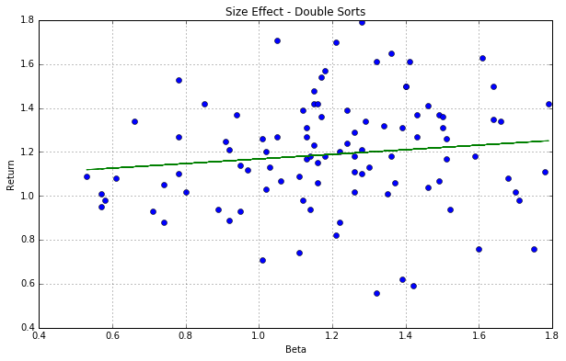
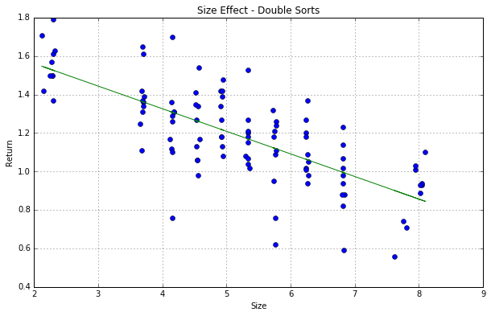
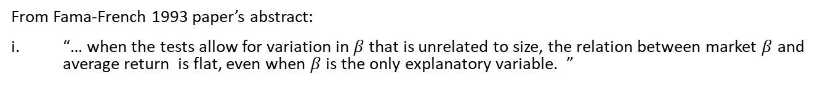
Informal Testing: Example of Double Sorts
Description: Sort all stocks by size and divide in 10 portfolios, then sort each of these portfolios by beta and divide in 10 again forming 100 portfolios in total
Small slope
Large slope
From Fama-French 1993 paper’s abstract:
“… when the tests allow for variation in $β$ that is unrelated to size, the relation between market $β$ and average return is flat, even when $β$ is the only explanatory variable. ”

